Slide 1
Rationale behind selected treatments: Sushruta's C- section
Done By:

Slide 2

The definition of an ideal surgeon according to the great surgeon Sushruta is “A person who possesses courage and presence of mind, a hand free from perspiration, tremor less grip of sharp and good instruments and who carries his operations to the success and advantage of his patient who has entrusted his life to the surgeon. The surgeon should respect this absolute surrender and treat his patient as his own son.”

Slide 3
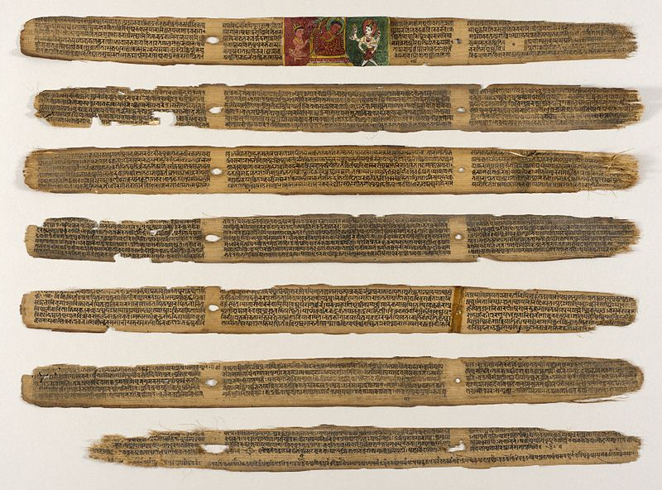
Surgery forms a major role in general medical training. The ancient surgical science was known as Shalya Tantra. Shalya means broken arrow or a sharp part of a weapon and Tantra means maneuver. Shalya Tantra embraces all processes, aiming at the removal of factors responsible for producing pain or misery to the body or mind. Since warfare was common then, the injuries sustained led to the development of surgery as refined scientific skill.

Slide 4
All the four Vedas are in the form of Shlokas (hymns), verses, incantations, and rites in Sanskrit language. This treatise contains detailed descriptions of teachings and practice of the great ancient surgeon Sushruta and has considerable surgical knowledge of relevance even today.
The Rigveda - the earliest account of ancient Indian civilization - mentions that Ashwini Kumaras known as Dev Vaidya were the chief surgeons of Vedic periods, who had performed rare legendary surgical operations which included the first plastic surgery to re-join the head and trunk of saint Chyavana when Dakshya cut his head. Their other classic work included an eye operation of Reejashva, the implantation of teeth of Phushna in the toothless mouth, and the transplant of head of elephant on Ganesh whose head was cut by Lord Shiva.

Slide 5
They transplanted an iron leg on Bispala - the wife of King Khela who lost her leg in war. Ashwini Kumaras had performed both homo- and hetro-transplantation during the very the ancient time of Rigveda which is estimated about 5000 years ago; such miraculous magical surgical skill of the Rigvedic period may seem mere legends or mystery to modern medical sciences. The surgical skill has traversed through the ages ranging from the Ashwini Kumaras, Chavana, Dhanvantari through Atereya Agnivesh and Shushruta. Craniotomy and brain surgery were also practiced in a more sophisticated way.

Slide 6
They do reflect some special surgical skills which laid down the foundation of Ayurveda - the fifth Indian Veda, the classical medical system of India. However, the realistic and systematic earliest compendium of medical science of India was compiled by Charak in Charak Samhita. It describes the work of ancient medical practitioners such as Acharya Atreya and Acharya Agnivesh of 800 BC and contains the Principle of Ayurveda. It remained the standard textbook of Ayurveda for almost for 2000 years. They were followed by Sushruta, a specialist in cosmetic, plastic, and dental surgery (Sandhan Karma around 600BC).

Slide 7
There are many Granthas and Samhitas dealing with Ayurveda; among them, Charak Samhita, Sushrutaa Samhita, and Ashtanga Sangraha are the three main pillars of Ayurveda. Charak Samhita and Ashtanga Samhita mainly deal with medicine knowledge while Sushrutaa Samhita deals mainly with surgical knowledge. Complicated surgeries such as cesarean, cataract, artificial limb, fractures, urinary stones plastic surgery, and procedures including per- and post-operative treatment along with complications written in Sushrutaa Samhita, which is considered to be a part of Atharva Veda, are surprisingly applicable even in the present time.

Slide 8
C-Section and history
A Caesarean section is defined as “the surgical termination of pregnancy or delivery by operative opening of the uterus”.
Caesarean sections ancestory can be traced back to the ancient (Graeco-Roman) world. Though there is very little information still extant about practices of this kind in antiquity, there are many folktales and popular stories from all over the world that tell of people being born in this fashion.
Indian religious books describe the birth of Buddha through his mother’s right flank. Brahma was believed to be born through the umbilicus of his mother.

Slide 9
C-Section and history
Sage Sushruta, a founder of ancient Hindu medicine mentions the importance of performing a post-mortem caesarean section in his medical treatise “Sushruta Samhita”.
There is a lot of evidence to suggest that knowledge and practice of this type of procedure was practiced in ancient Greece, ancient Rome and even ancient India.
It is these early practices, from this part of the world, which are thought to have formed the foundations for what is known today in the modern Western medicine as the “caesarean section”.

Slide 10
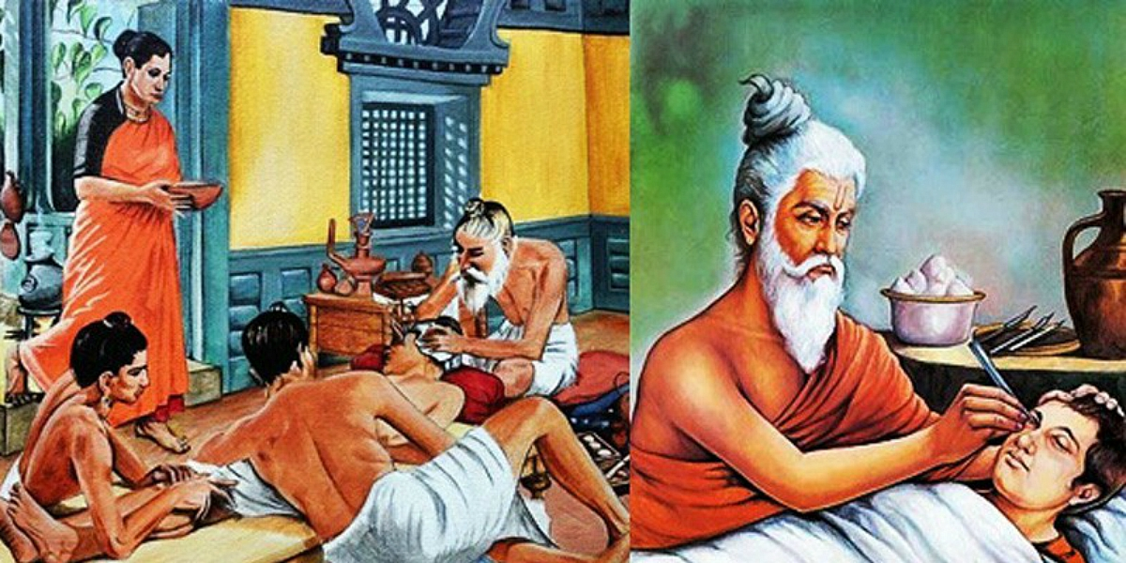
C-Section
A C-section, also called a cesarean section or cesarean delivery, is a surgical procedure in which a baby is delivered through incisions in your abdomen and uterus. They're performed when a vaginal delivery is not possible or safe, or when the health of you or your baby is at risk.

Slide 11
How common are C-sections?
According to the Centers for Disease Control (CDC), C-sections account for about 30% of all deliveries in the United States.
What actually happens during a C-section?
The first step in a C-section procedure is preparing you for anesthesia. Most planned C-sections use an epidural, so you are awake for the delivery. However, in some cases, you're asleep under general anesthesia.
Your abdomen will be cleaned with an antiseptic, and you might have an

Slide 12
oxygen mask placed over your mouth and nose to increase oxygen to your baby. Next, your provider places a sterile drape around the incision site and over your legs and chest. Finally, your providers raise a sterile curtain or drape between your head and your lower body.
The obstetrician will then make an incision through your skin and into the wall of your abdomen. They might use either a vertical or transverse incision. A horizontal incision is also called a bikini incision.
Next, your provider cuts a 3- to 4-inch incision into the wall of your uterus. This incision can also be transverse or vertical. Finally, the obstetrician removes your baby through the incisions. The umbilical cord is cut, the placenta is removed and the incisions are closed with stitches and staples.

Slide 13
Emergency C-sections follow the same steps; however, the speed at which your baby is removed is different. During a planned C-section, the delivery takes about 10 to 15 minutes. Your provider removes your baby in only a few minutes in an emergency C-section.
If you're awake for your C-section surgery, you will be able to see and hold your baby shortly after it's born.
What does a C-section feel like?
You'll be under anesthesia, which should prevent you from feeling any pain. Most people report feeling a tug or pull when their baby is removed from their abdomen.

Slide 14
Are C-sections safe?
Vaginal births are usually preferred, but in some cases, a C-section is the only safe option. For example, a C-section is the safer option when your baby is breech or you have placenta previa (placenta covers part of the cervix). A C-section carries risks and benefits, which should be discussed with your pregnancy care provider.
How long does a C-section surgery take?
The typical C-section takes about 45 minutes from start to finish. After your provider delivers your baby, they'll stitch your uterus and close the incision in your abdomen. Different types of emergencies can arise during a delivery. In some cases, the delivery will happen very quickly, with your baby being delivered in as little as 15 minutes. This is an emergency C-section.

Slide 15
What happens after a C-section?
Like vaginal births, your obstetrician will deliver the placenta after your baby is born. Next, your provider will stitch your uterus and stitch or staple your abdominal muscles. Stitches should dissolve, but staples are removed at the hospital about one week later. Your abdomen will be sore for several days or weeks. In some cases, your provider may prescribe stronger pain medication.
You can expect to limit your activities, take it easy and rely on family and friends once you go home. A typical C-section surgery requires at least two to three days in the hospital.

Slide 16
What are the benefits of a C-section?
The advantages of a C-section depend on your pregnancy. In most cases, the biggest benefit of a C-section is that it's safer for both you and your baby. When a vaginal birth is risky or could hurt your baby, most providers will turn to a C-section to minimize risks. Sometimes C-sections are unplanned. For example, if your baby's heart rate drops to an unsafe level, an emergency C-section is safer than letting your baby's heart rate decline further.

Slide 17
Have a nice day!!
THANK YOU

